Slide 1

PRATHYUSHA ENGINEERING COLLEGE
DEPARTMENT : CSE – CYBER SECURITY
SUBJECT : MINI PROJECT
TITLE :AI CYBERSECURITY ASSISTANT
TEAM MEMBERS :
HARISH B - 11142301CB05016
STAINES CHRISTOPHER C - 11142301CB05044
VASANTH N - 11142301CB05048

Slide 2

PROBLEM STATEMENT
Traditional cybersecurity systems mainly depend on fixed rules and known threat signatures. These systems may struggle to identify new phishing messages, suspicious user behavior, and previously unseen attacks.
Users also find it difficult to determine whether an email or message is safe or malicious.
Problems Identified :
Increasing phishing and scam messages
Difficulty identifying malicious messages
Unknown or new attack patterns
Unusual user activities may go unnoticed
Large volumes of security events are difficult to monitor manually
Slow identification of suspicious activities

Slide 3
OBJECTIVES
To develop an AI Cybersecurity Assistant that uses machine learning to identify suspicious messages and abnormal user behavior.
Specific Objectives
Detect phishing messages using Natural Language Processing
Classify messages as Safe or Phishing
Provide a phishing prediction confidence score
Analyze user activity for abnormal behavior
Identify suspicious login patterns
Classify activities as Normal or Suspicious
Provide a simple cybersecurity dashboard
Reduce the need for manual security monitoring

Slide 4
EXISTING SYSTEM
Existing System
Traditional cybersecurity solutions commonly use rule-based detection and predefined signatures to identify known threats.
Limitations
Depends heavily on predefined rules
Difficult to detect new phishing patterns
Cannot easily identify unknown threats
Requires continuous manual updates
Large numbers of alerts can overwhelm users
Limited understanding of individual user behavior
May generate false positives

Slide 5
LITERATURE SURVEY
Year | Title | Findings | Limitations
2022 | Phishing Email Detection Using NLP Techniques | NLP improves phishing email detection. | Phishing patterns keep changing.
2022 | Phishing URL Detection: A Real-Case Scenario | ML effectively detects phishing URLs. | Performance drops on newer data.
2019 | Phishing Email Detection Using Robust NLP Techniques | NLP techniques help identify phishing emails. | Depends on effective text features.
2022 | UEBA Log Data Set for Anomaly Detection | UEBA supports user-behavior anomaly detection. | Dataset focuses on cloud environments.
2022 | Anomaly Detection Using UEBA | UEBA identifies unusual user activity. | Requires sufficient activity/log data.

Slide 6
PROPOSED SYSTEM
The proposed AI Cybersecurity Assistant uses machine learning and data-driven analysis to identify cybersecurity threats.
The system contains two main modules:
1. AI Phishing Detection
Uses NLP + TF-IDF + Logistic Regression to analyze messages and classify them as:
Safe / Phishing
2. User Behavior Anomaly Detection
Uses Isolation Forest to analyze user activity and identify:
Normal / Suspicious
Features
Phishing message detection
NLP-based text analysis
Machine learning classification
User behavior monitoring
Anomaly detection
Confidence/result display
Security dashboard
Real-time analysis of submitted data

Slide 7
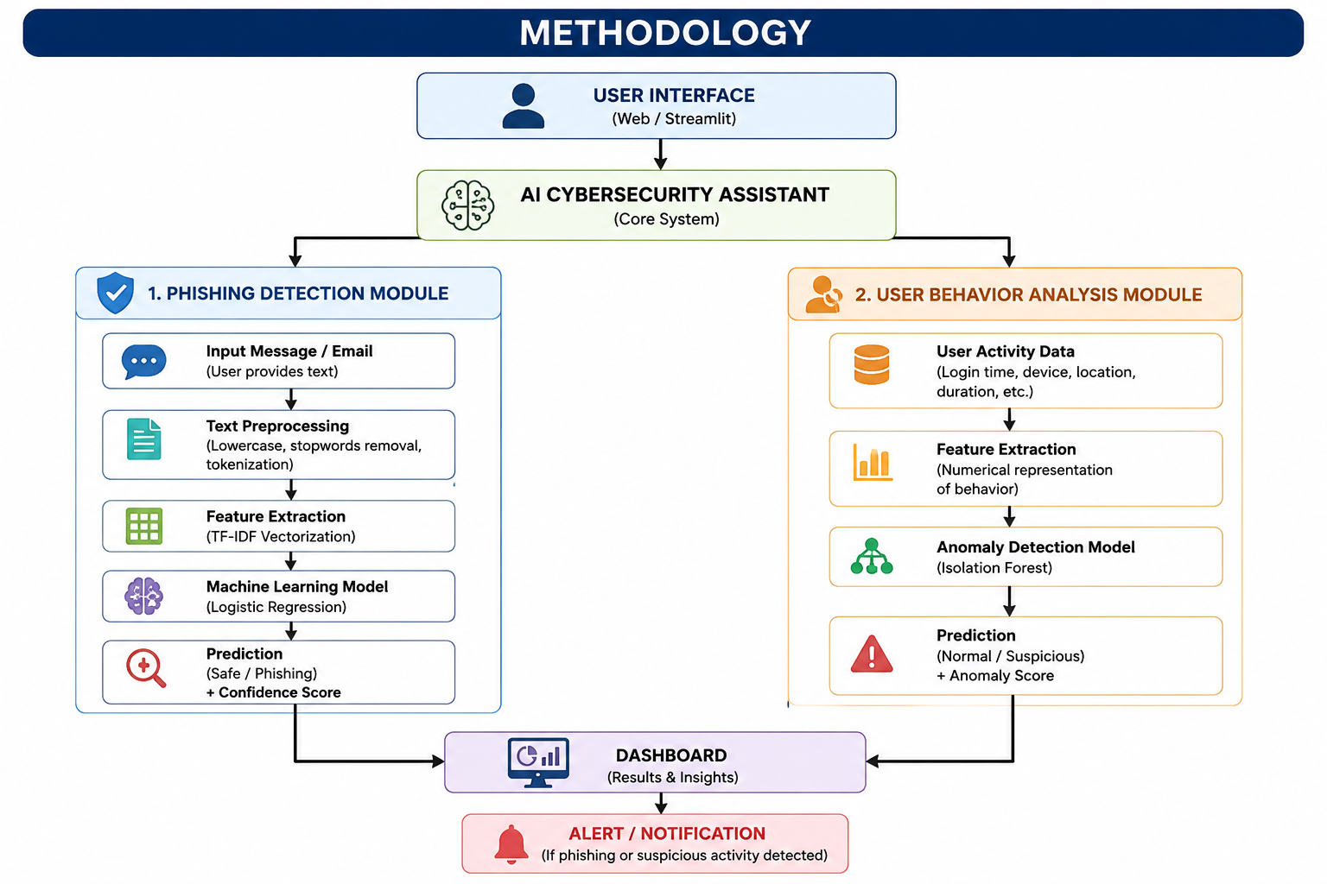
System Architecture

Slide 8
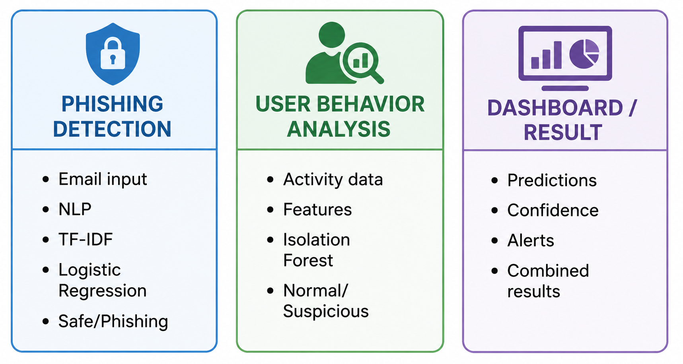
LIST OF MODULES

Slide 9
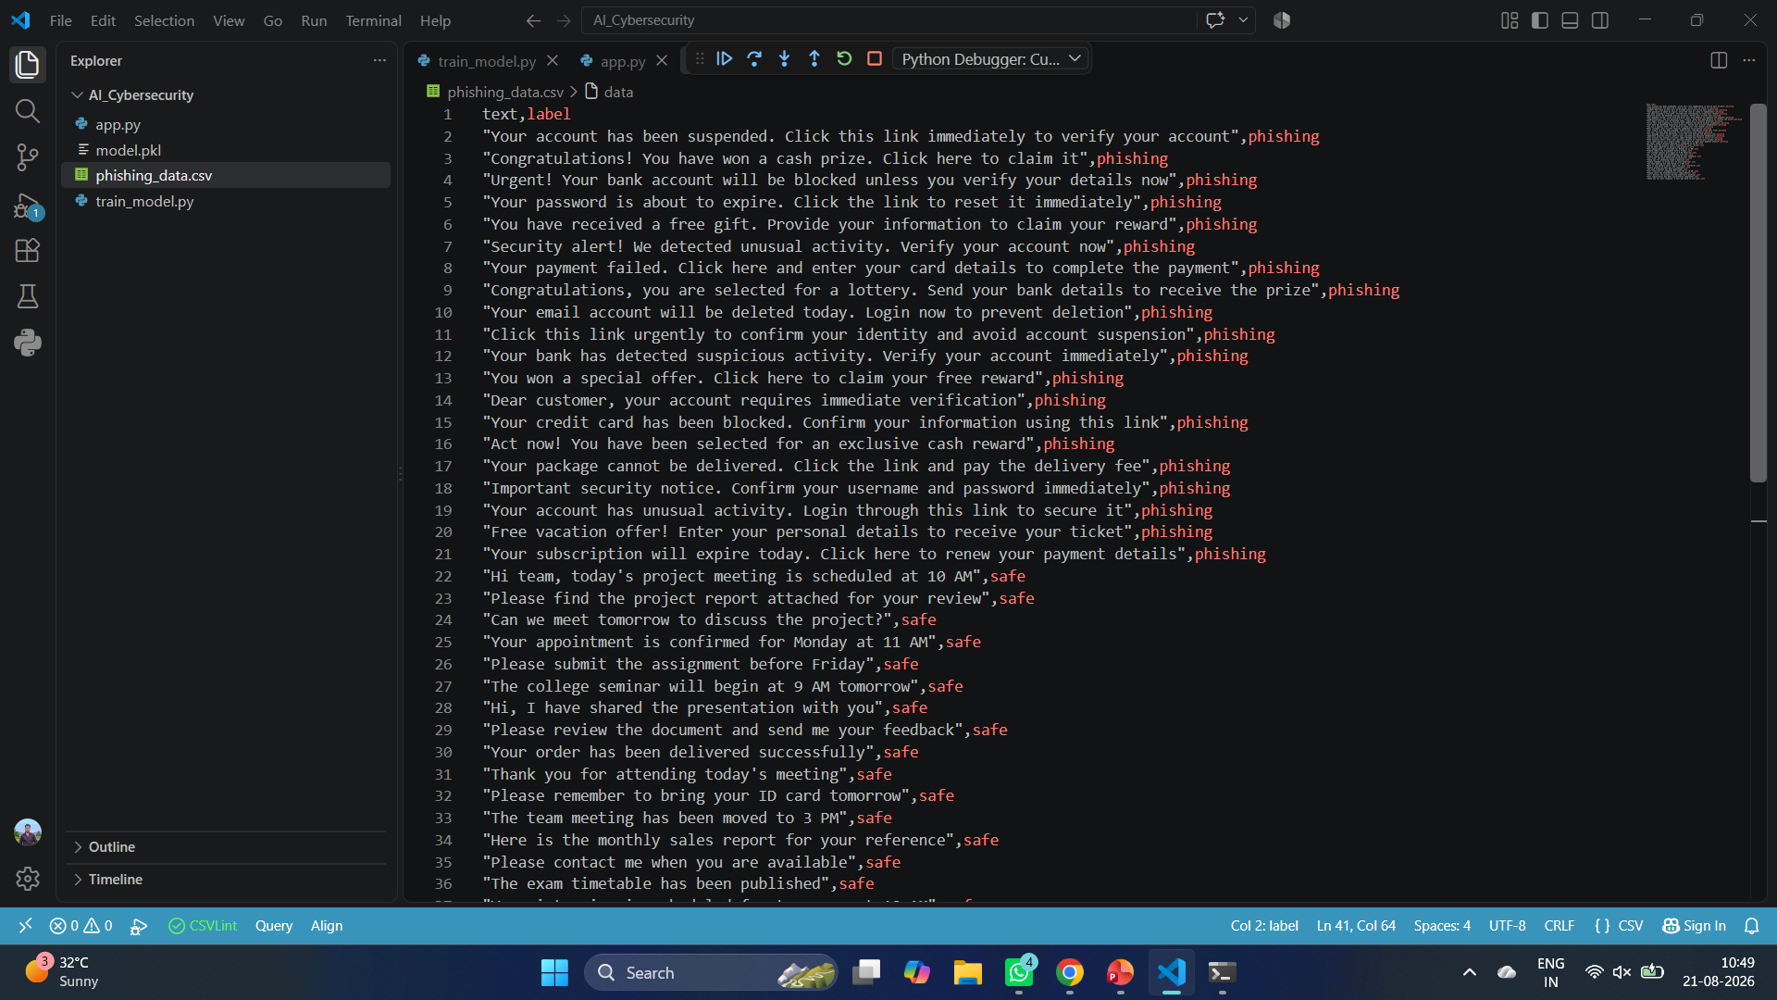
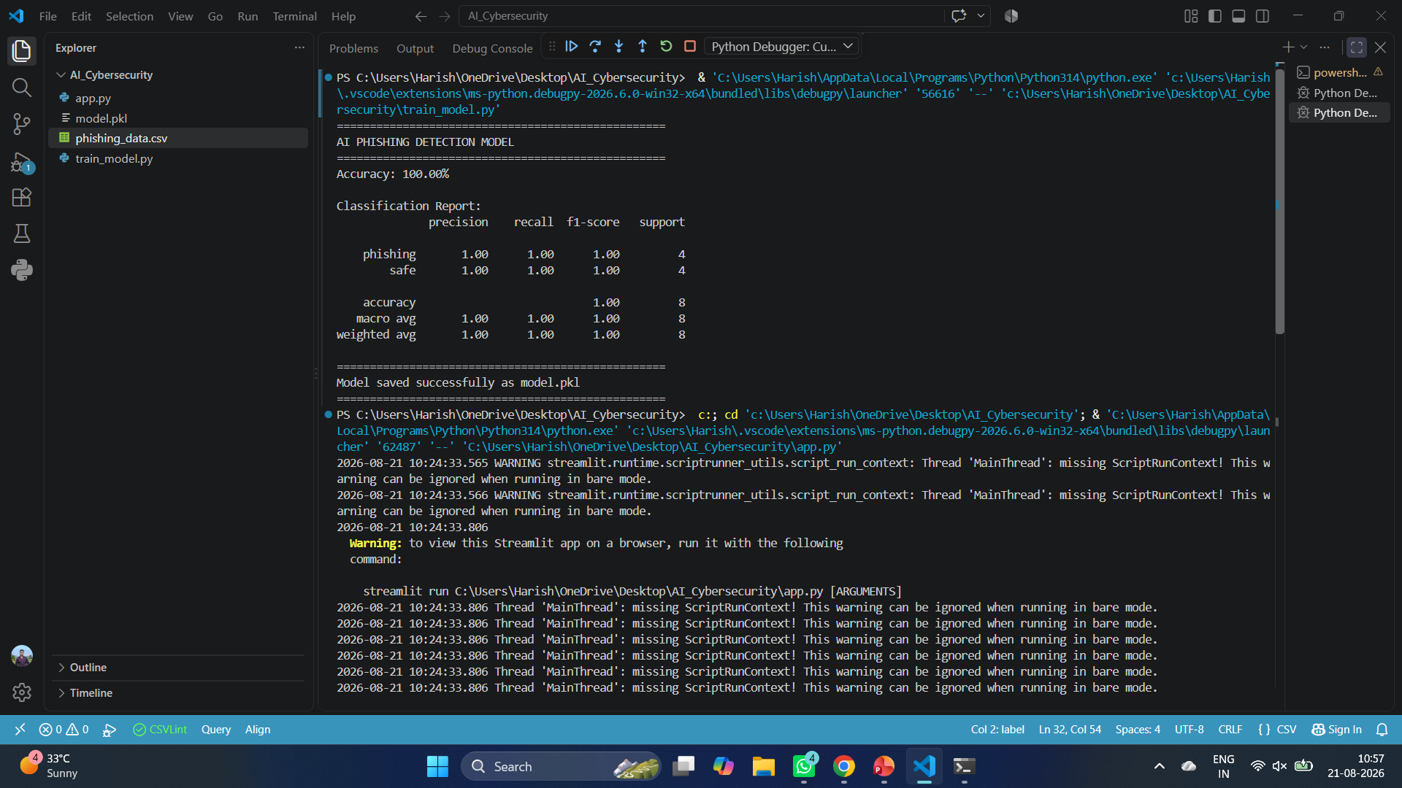
MODULES COMPLETED
1. Dataset Preparation
phishing_data.csv created
Safe & Phishing messages prepared
2.Model Development

Slide 10
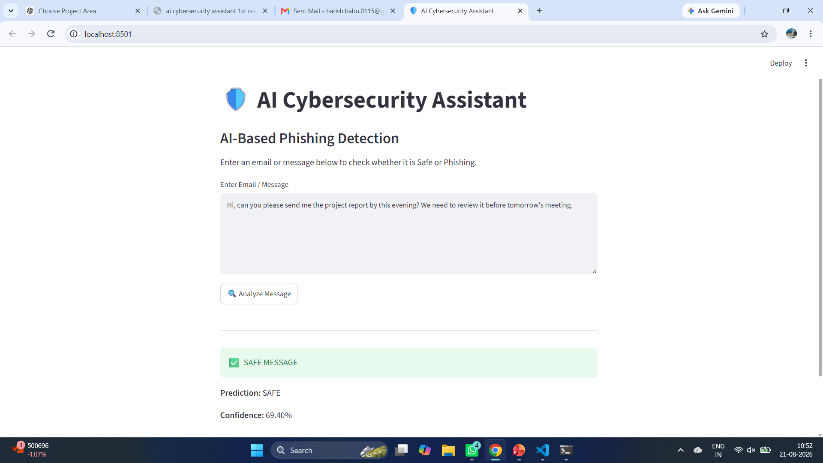
MODULES COMPLETED
3.Working Application

Slide 11
PROJECT TIMELINE
Phase | Duration
Requirement Analysis | Week 1
Problem & Dataset Analysis | Week 1
System Design | Week 1
Dataset Preparation | Week 1
NLP Model Development | Week 2
Phishing Detection Module | Week 2
Behavior Anomaly Module | Week 3
Streamlit Dashboard | Week 3
Testing | Week 3
Documentation | Week 4
Final Presentation | Week 4

Slide 12
TECHNOLOGY STACK
Category | Technology
Programming Language | Python
Machine Learning | Scikit-learn
NLP | TF-IDF
Classification | Logistic Regression
Anomaly Detection | Isolation Forest
Data Processing | Pandas
Web Framework | Streamlit
Model Storage | Joblib
Dataset | CSV
Development Tool | VS Code

Slide 13
FEASIBILITY OF THE PROJECT
Technical Feasibility
Python
Pandas
Scikit-learn
Streamlit
TF-IDF
Logistic Regression
Isolation Forest
Joblib
CSV dataset
Open-source technologies
Schedule Feasibility
Can be developed in phases
Phishing module can be completed first
Behavior module can be added afterward
Testing and presentation can follow implementation
Economic Feasibility
No expensive software required
Open-source libraries
Low development cost
Can run on a normal laptop
Operational Feasibility
Simple user interface
Easy message analysis
Easy-to-understand results
Dashboard-based monitoring

Slide 14
ADVANTAGES
Detects phishing messages using AI
Uses NLP for text analysis
Identifies abnormal user behavior
Reduces manual monitoring
Provides quick security predictions
Simple and user-friendly interface
Uses open-source technologies
Can be expanded with additional AI models
Combines multiple cybersecurity detection techniques
Suitable for educational and demonstration purposes

Slide 15
REFERENCES
IEEE References
[1] S. Salloum, T. Gaber, S. Vadera, and K. Shaalan, “A Systematic Literature Review on Phishing Email Detection Using Natural Language Processing Techniques,” IEEE Access, vol. 10, pp. 65703–65727, 2022, doi: 10.1109/ACCESS.2022.3183083.
[2] M. A. Adebowale, K. T. Lwin, M. A. Hossain, and M. A. Islam, “Phishing detection: A recent intelligent machine learning comparison based on models content and features,” in Proc. IEEE Int. Conf. Intelligence and Security Informatics (ISI), 2017, doi: 10.1109/ISI.2017.8004877.
[3] N. Moradpoor, B. Clavie, and W. J. Buchanan, “Employing machine learning techniques for detection and classification of phishing emails,” in Proc. IEEE Computing Conference, 2017, doi: 10.1109/SAI.2017.8252096.
[4] L. F. Gutiérrez, F. Abri, M. Armstrong, A. S. Namin, and K. S. Jones, “Email Embeddings for Phishing Detection,” in Proc. IEEE Int. Conf. Big Data, 2020.
[5] M. Shashanka, M.-Y. Shen, and J. Wang, “User and Entity Behavior Analytics for Enterprise Security,” in Proc. IEEE Int. Conf. Big Data, 2016, pp. 1867–1874, doi: 10.1109/BigData.2016.7840805.

Slide 16
Thank you

